Slide 1
NBA ANALYTICS
Neha PAWAR

Slide 2
ObJECTIVE
The objective of this project is to visualize and understand the performance of the nba player and teams –for nba dataset for 2007-2008 & 2017-18.

Slide 3
About DATASET
Source - The raw data for this function is obtained from the website http://dougstats.com
Variables Used-sliced from original data
League-NBA(Name of the League)
Name-Name of the pLayer
Team-Team to which the player belongs
Gamesplayed - Number of games played by the player of the team
Totalminutesplayed – Number of minutes a player played.
Feildgoalsmade – number of goals made by a player
Fieldgoalsattempted - number of goals ATTEMPTED by a PLAYER.
PERSONALFOULS – Number of fouls Made BY player.
Disqualifications – NUMBEr of times a player is- disqualified.
TOTALpoints – Number of points scored by a player.

Slide 4
Data preprocessing/cleaning
For most of the part, the data was pretty clean. Only Few codes are executed to remove blank spaces, punctuation marks etc.

Slide 5
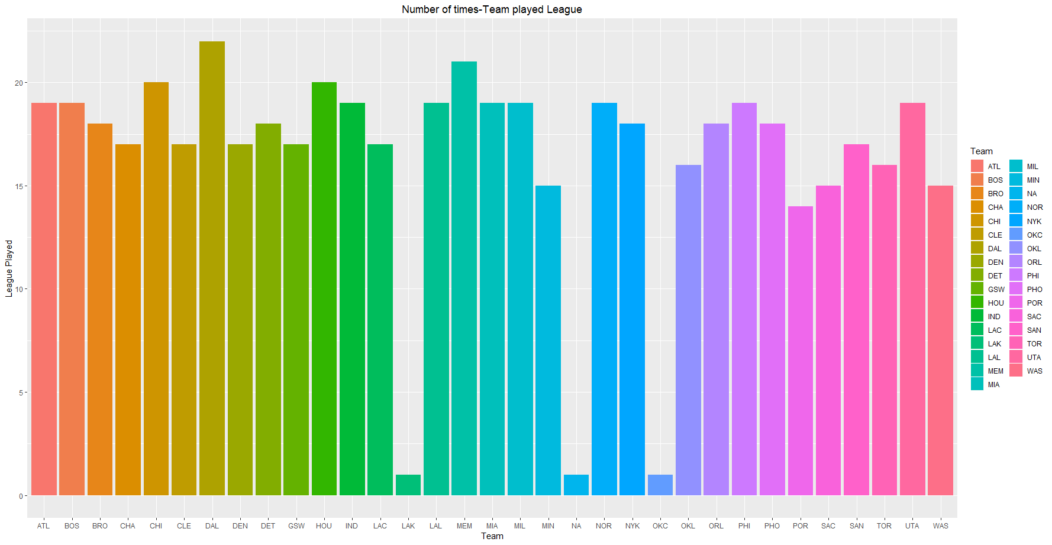
ANALYZING DATA
As the first Step we Visualize data- here we show the number of times a team played in a nba league.

Slide 6
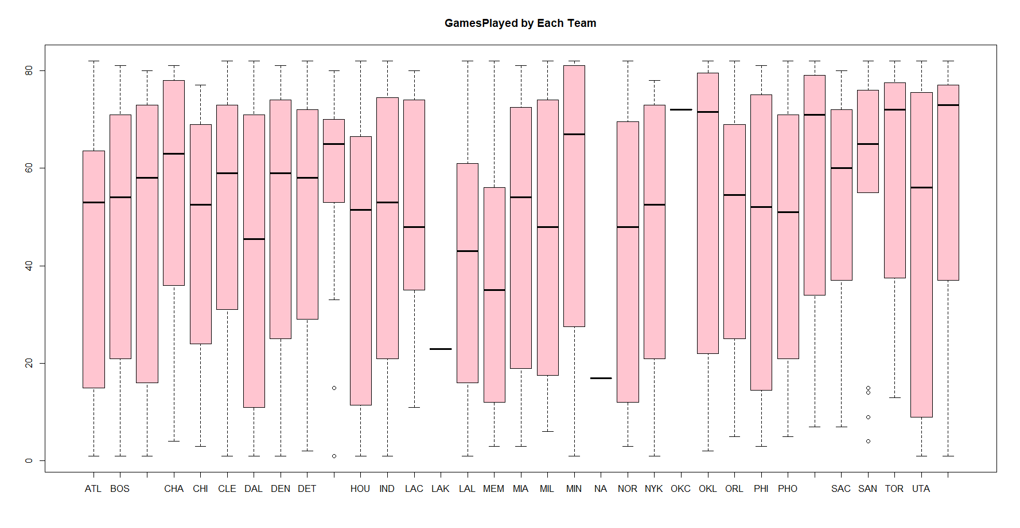
TEAm vs GAMESplayed
Here team –being a categorical variable and Gamesplayed, a numerical variable we draw their relationship as follows:-

Slide 7
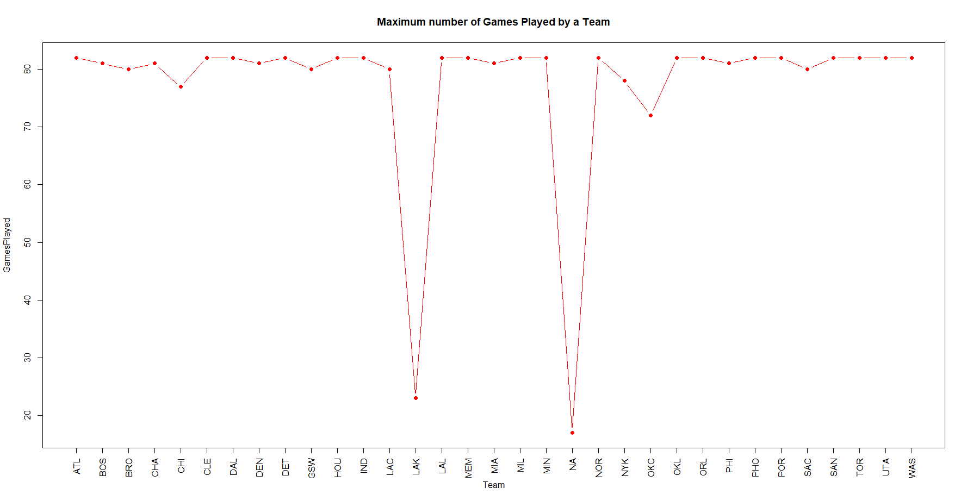
Maximum number of games by a team
Here we summarize maximum number of games played by a team

Slide 8
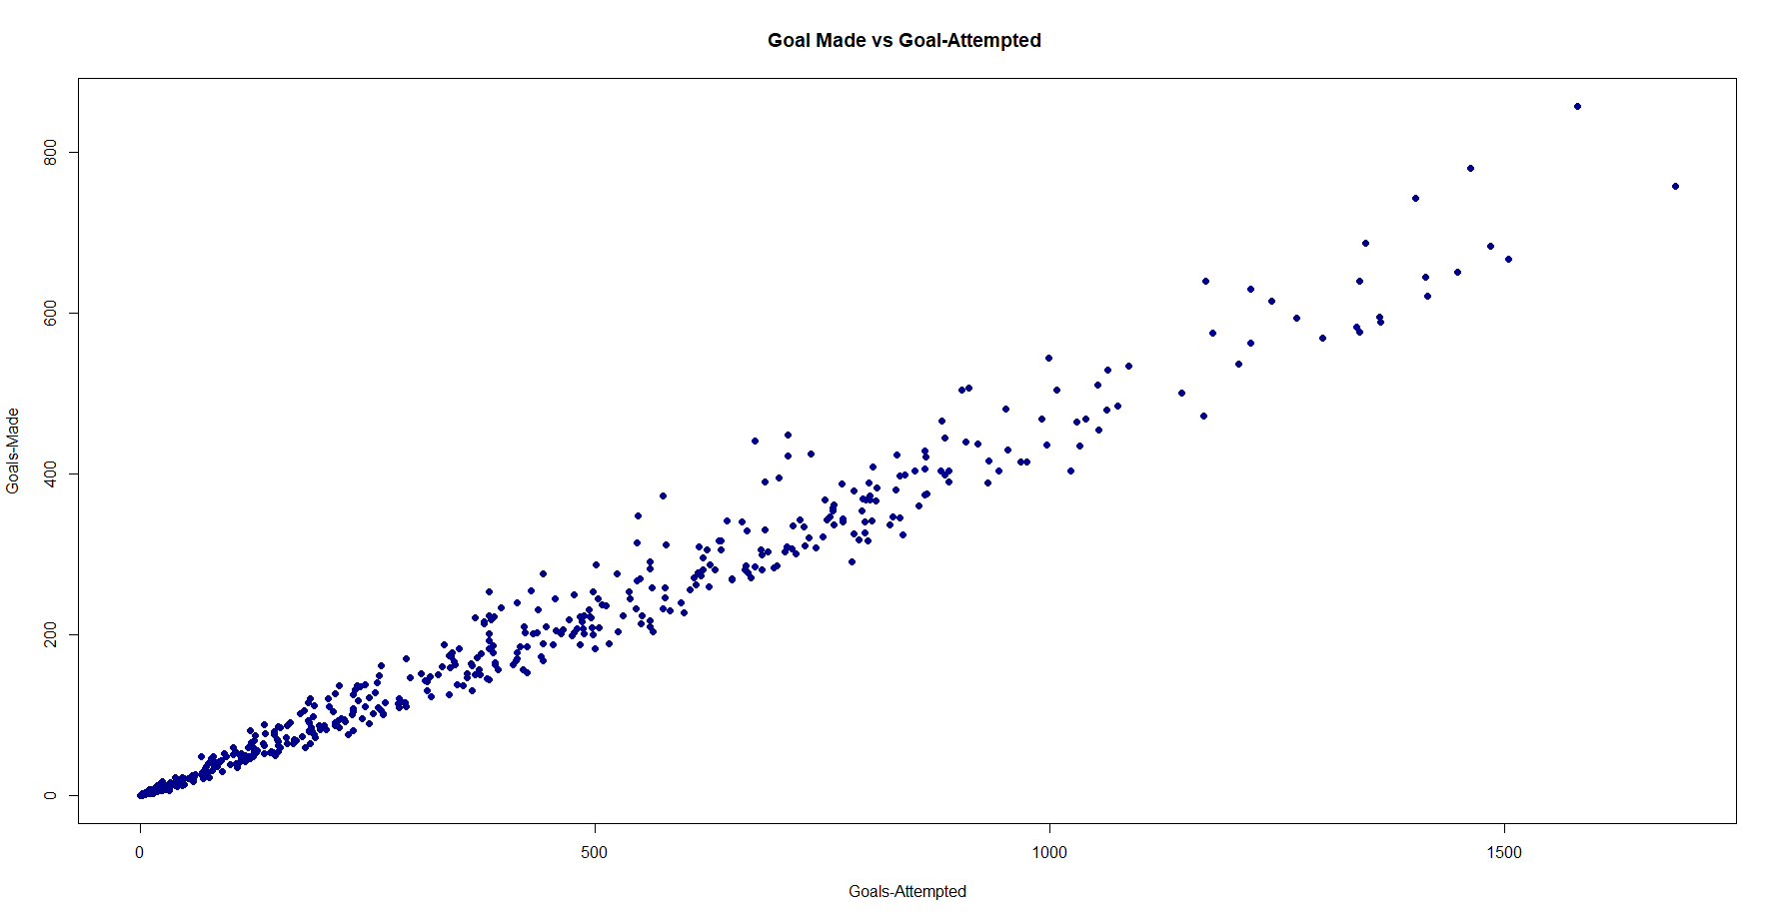
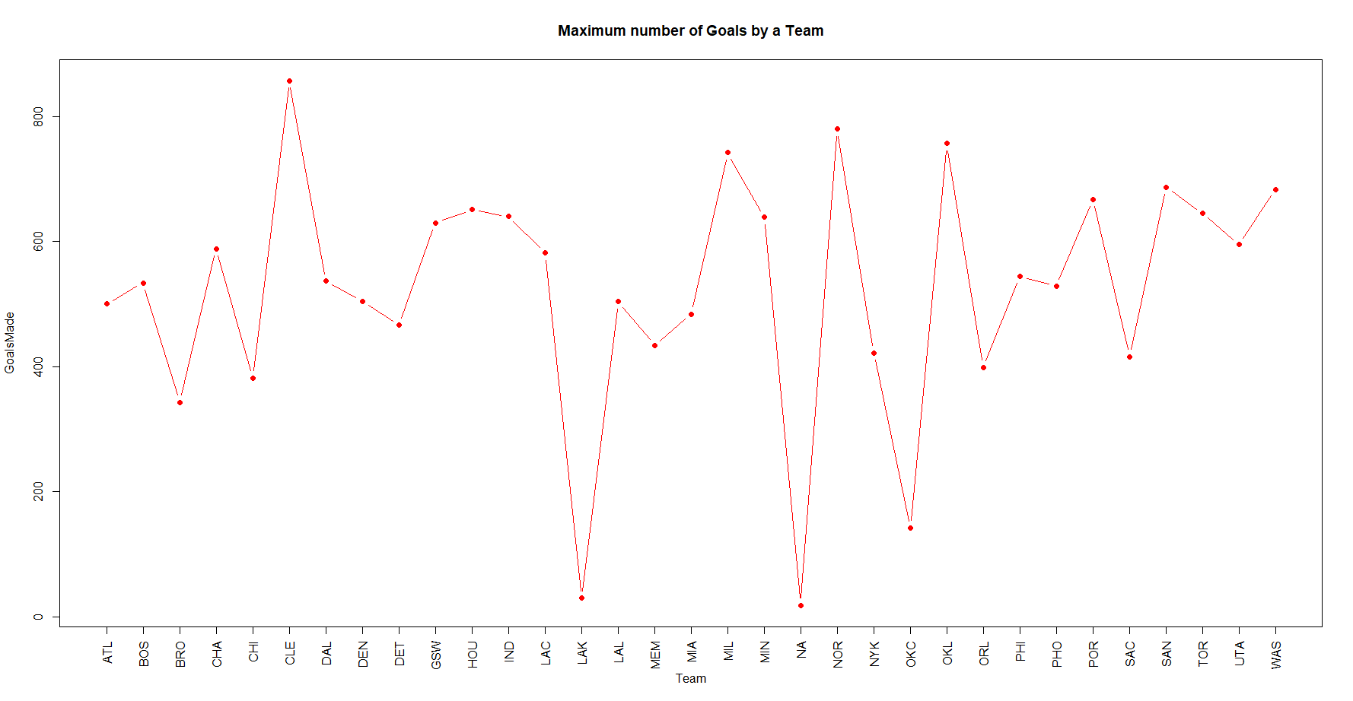
Success Rate-for GOALs
He we use both number variable –goals made vs attempted
Goal MADE VS GOAL ATTeMPTeD MAXIMUM NUMBER OF GOAL BY a TEAM

Slide 9
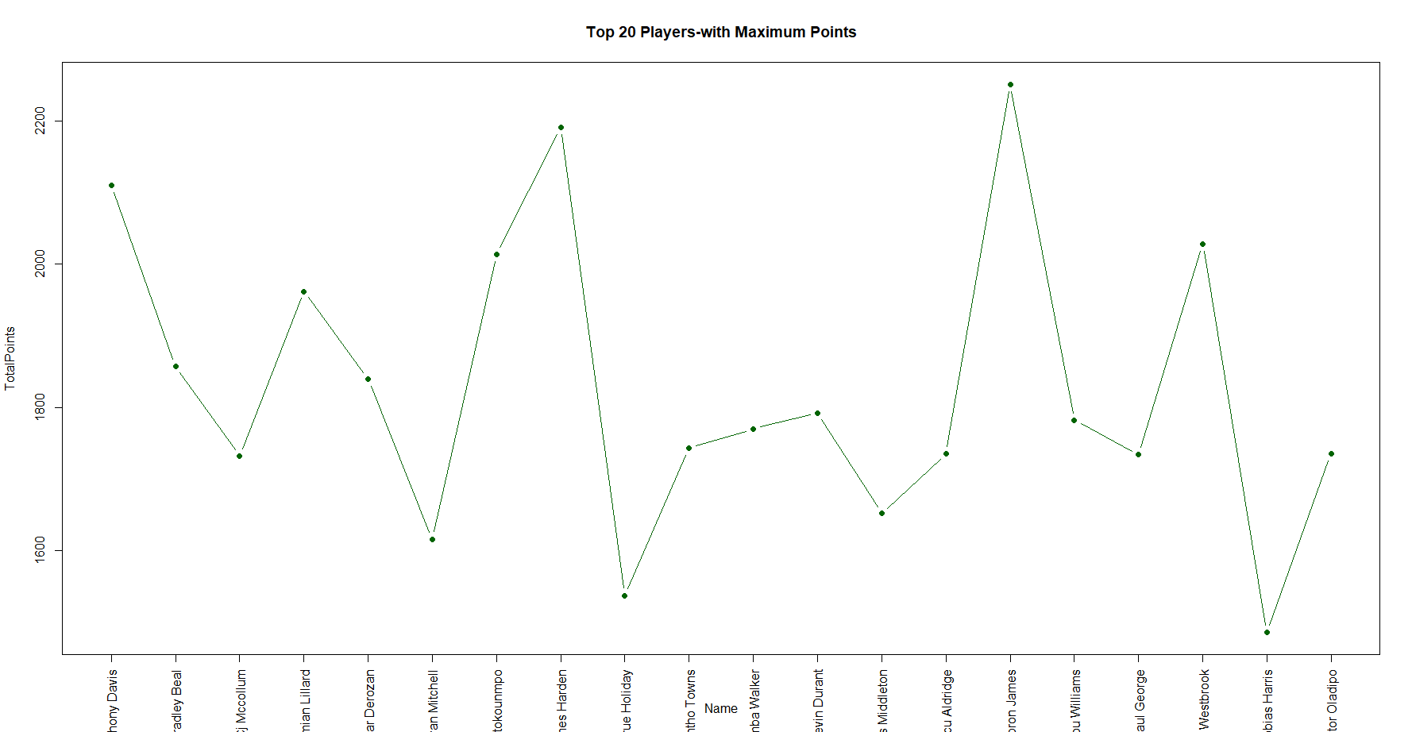
Finding Top 20- Player vs maximum points
We take player as a categorical variable and total points numerical variable for and find top 20 players on the basis of their total points.

Slide 10
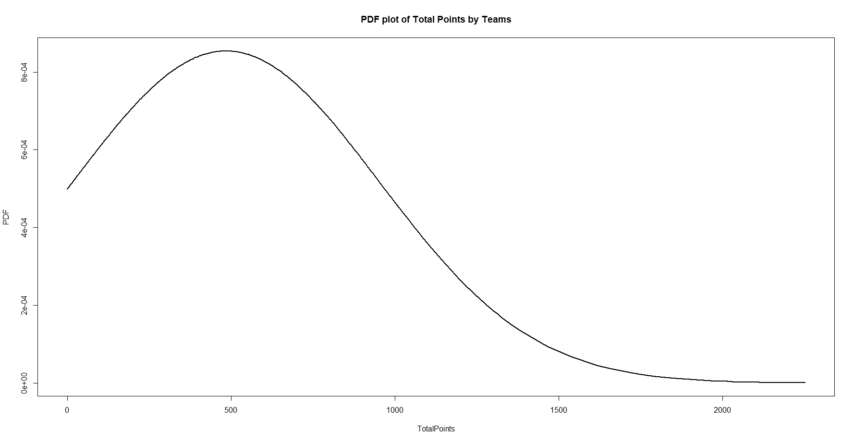
Distribution
We take total points as numerical variable and PLOT pDF for it.

Slide 11
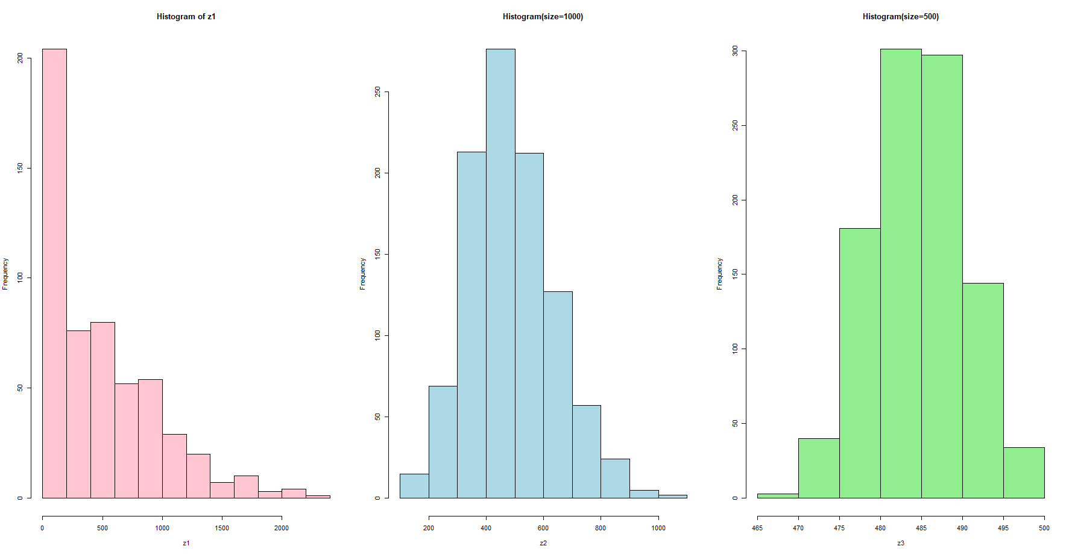
CENTRAL LIMIT THEOREM
applying central limit theorem approach on totalpoints score by a player –using three sets of samples

Slide 12
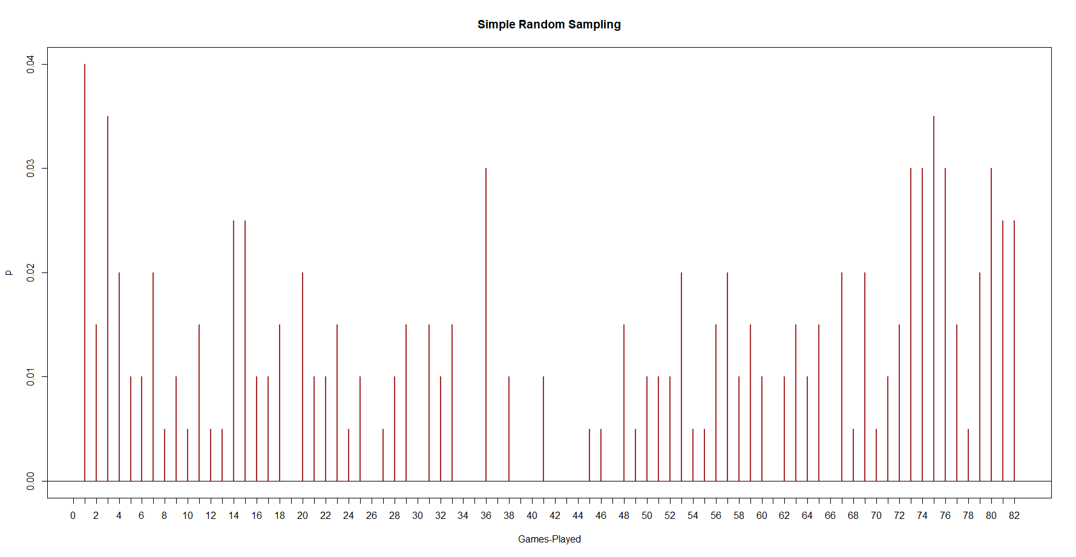
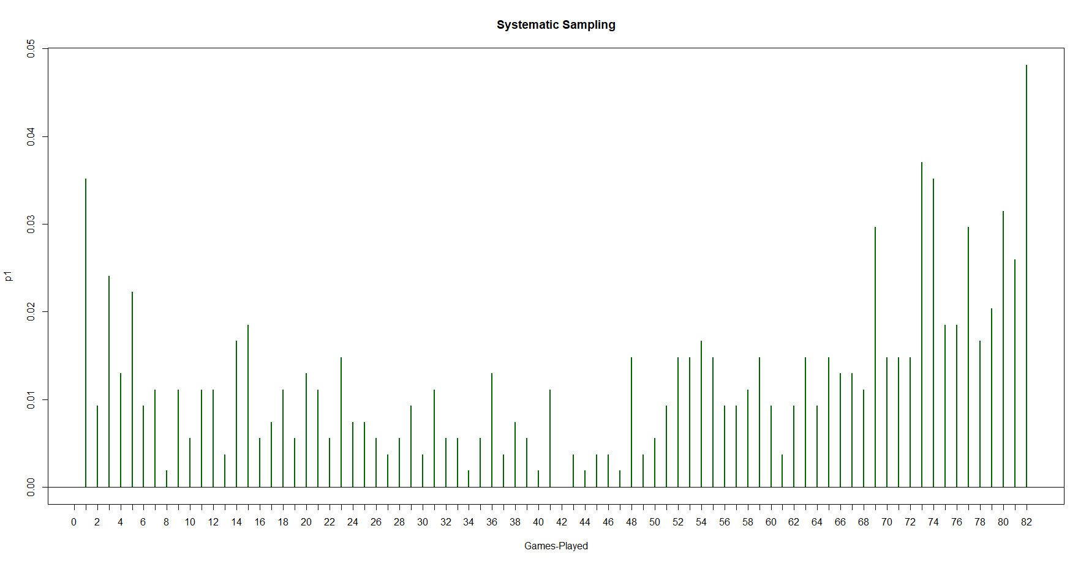
SAmplING
Showing various sampling methods- on number of Gamesplayed
SIMPLE RANDOM SAMPLING SYSTEMATIC SAMPLING

Slide 13
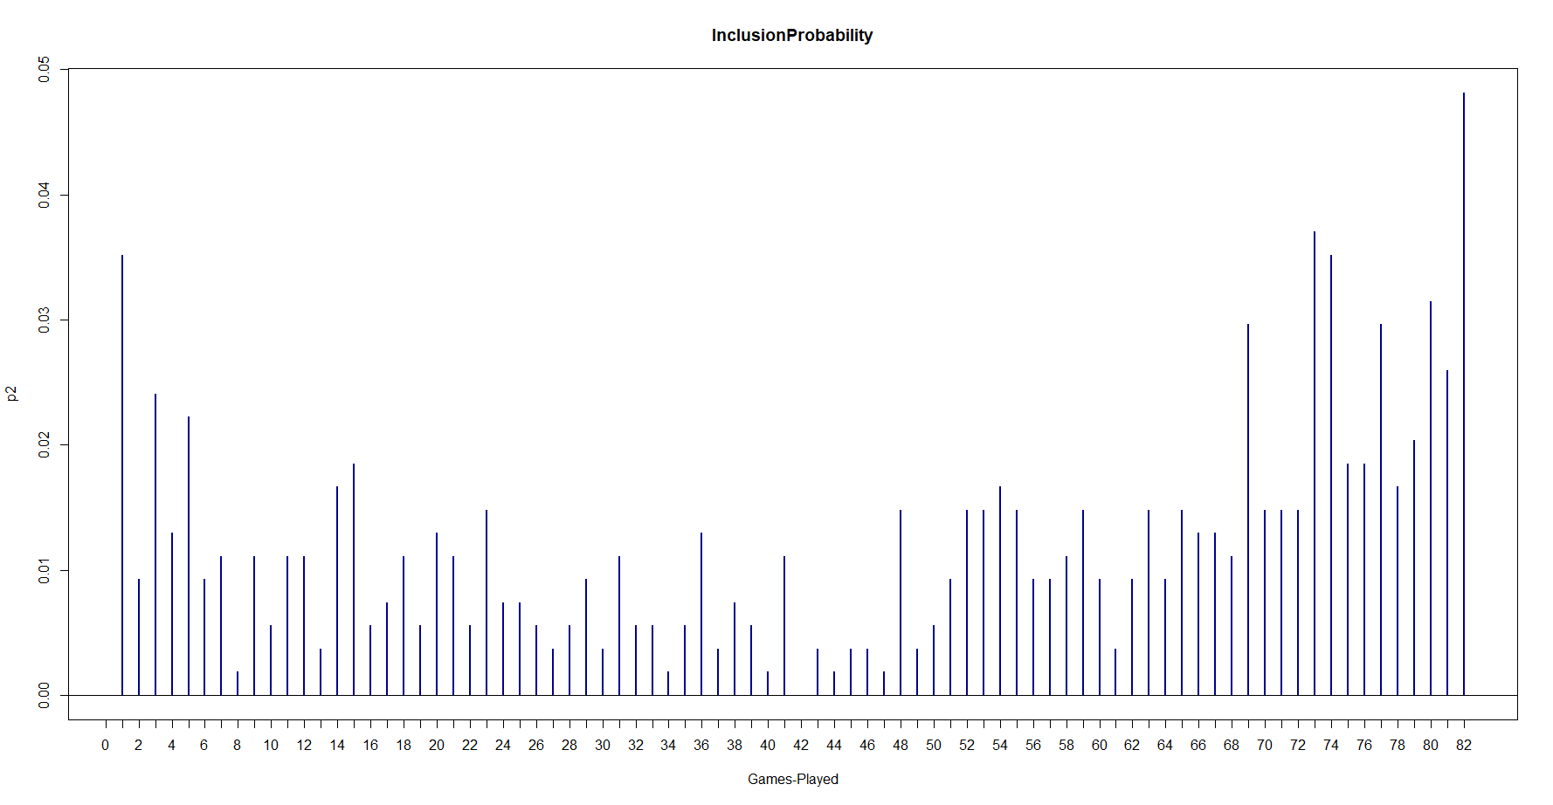
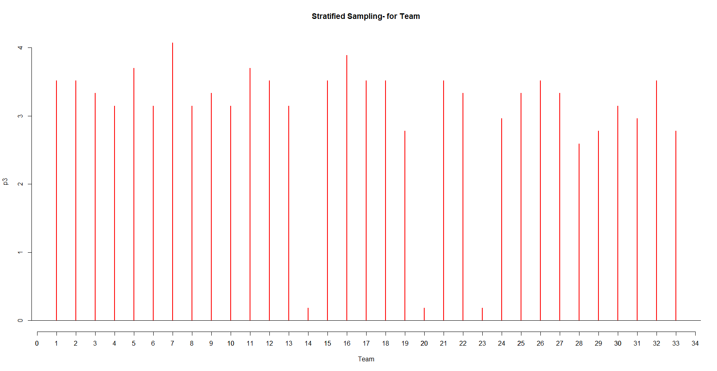
SAMPLING…cntd
Inclusion probabilities STRATIFIED SAMPLING ON TEAM

Slide 14
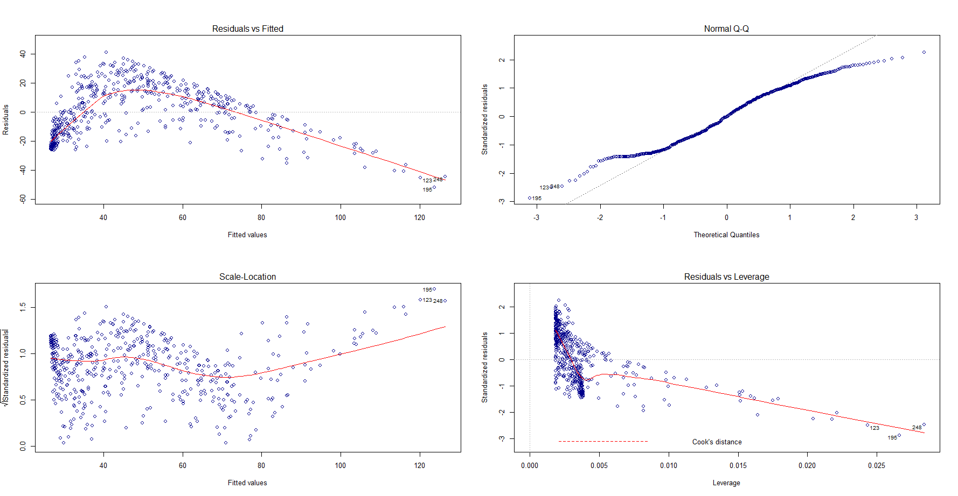
Correlation and Residuals plot- Gamesplayed vs TotalPOINTS

Slide 15
Preparing Data aND Loading LIBRARIES
AS the FIRST STEP I load all the required libraries

Slide 16
Subset DATA BY TEAm(BOSTON) AND PROCESS
We CHOSE and subset data for BOSTON .
Apply filters for FINDINGS-”RAY ALLEN ”-has best three point %,”Paul Pierce” has largest number of minutes and “ Rajon Rondo” has most “steals”.

Slide 17
Five 5 –with most wins
Here I have used totalpoints to decide for the wins for each team.
Alternate-for other data- I have used
An experimented on A different URL
to extract number of wins.

Slide 18
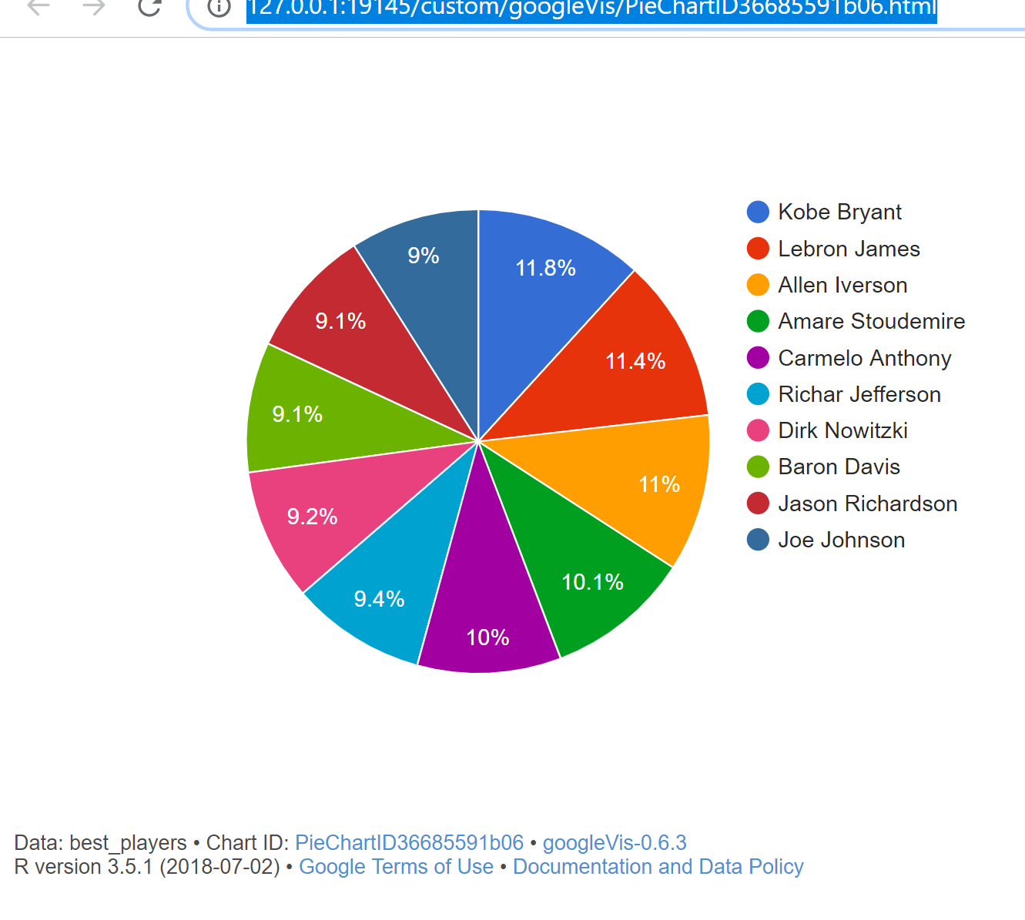
Five Google CHArts-CHART1(PIE-CHART)
CHART-1(PIE-CHART):On the BASIS of TOTalpoints I have retrieved Top 10 players and plot a google pie chart.

Slide 19
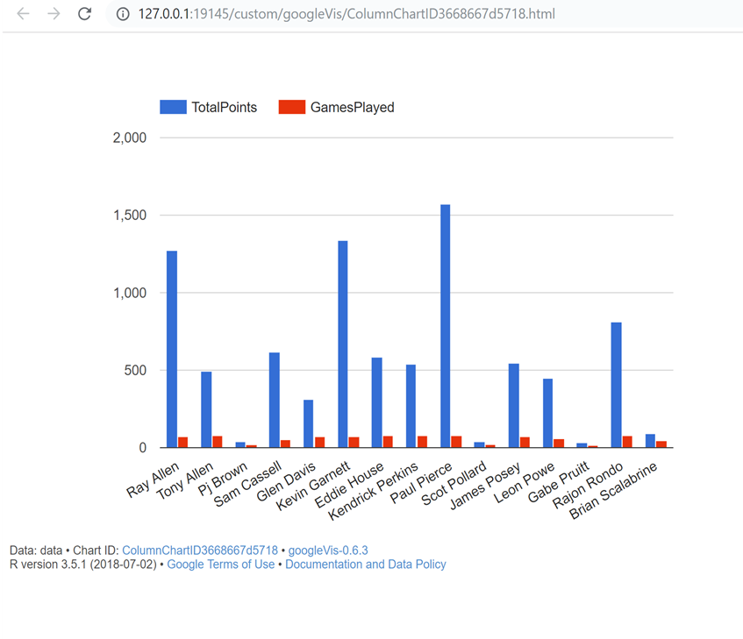
Five Google CHArts-CHART2 COLUmn CHART
CHART-2(COLUMN CHART):Here I have used TOTAL POINTS AND GAMES PLAYED to reflect performance FOR EACH PLAYER.

Slide 20
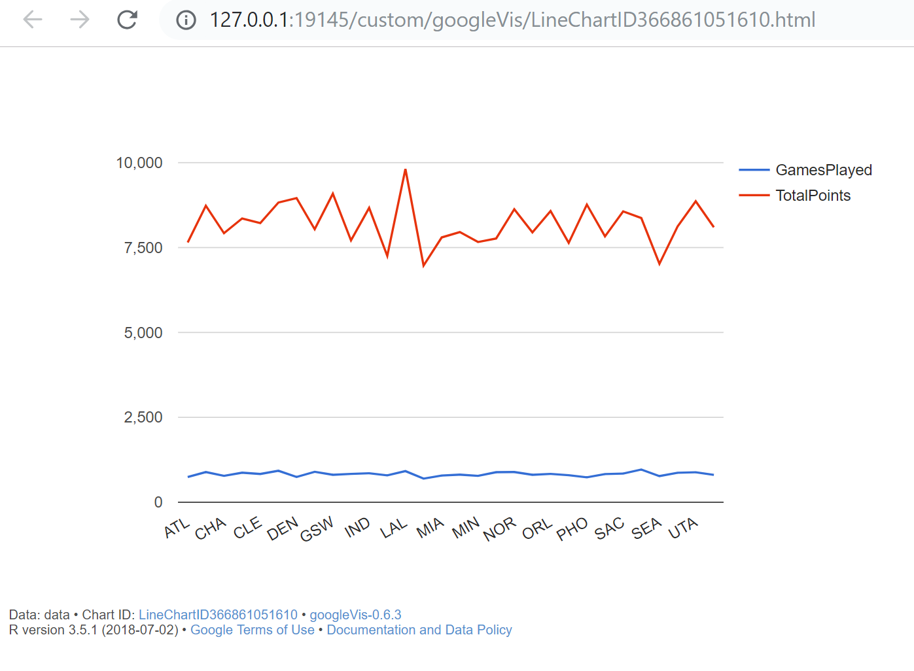
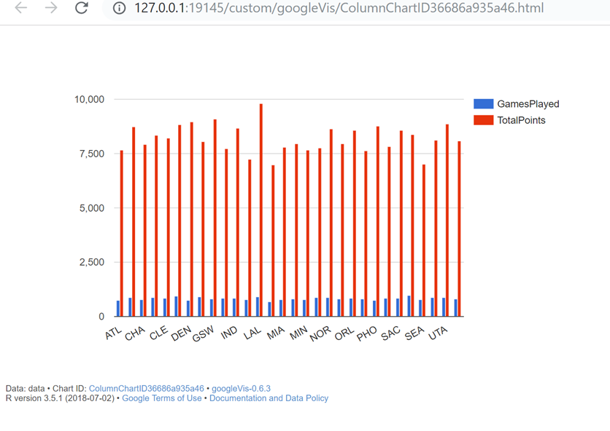
Five Google CHArts-CHART3 LINE/COLUMN CHART
CHART-3(Line/COLUMN CHART): Here I have used TOTAL POINTS AND GAMES PLAYED to reflect performance FOR EACH TEAMS.

Slide 21
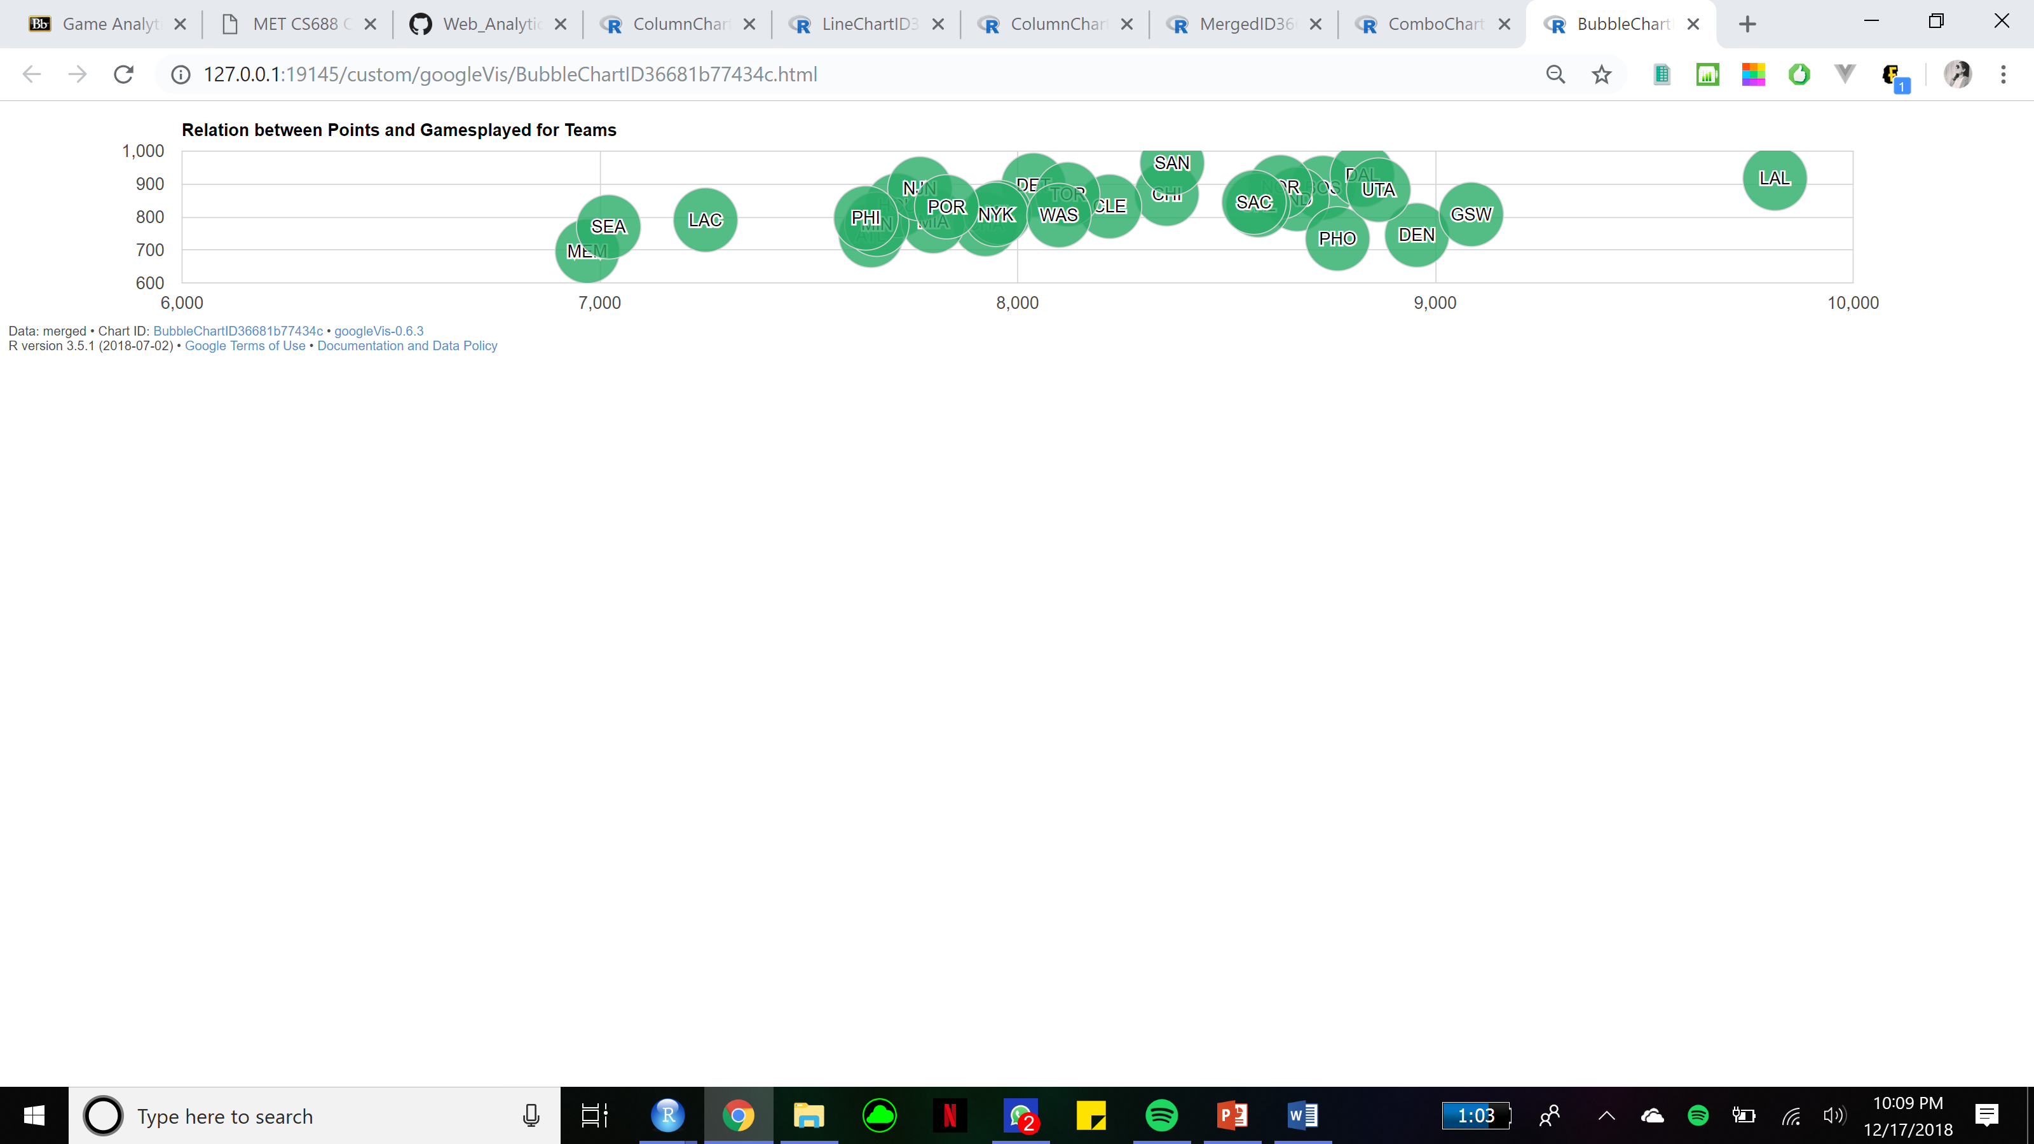
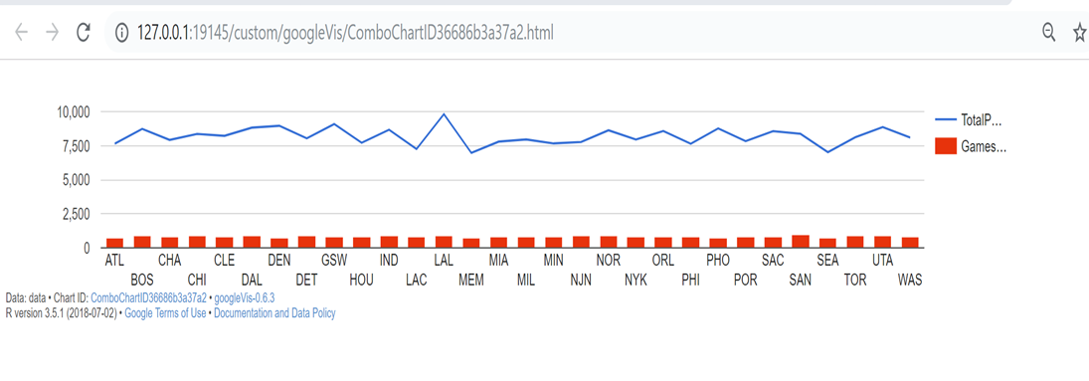
Five Google CHArts-CHART4 COMBO/BUBBLE CHART
CHART-4(COMBO/BUBBLE CHART): Here I have used TOTAL POINTS AND GAMES PLAYED to reflect performance FOR EACH TEAMS.

Slide 22
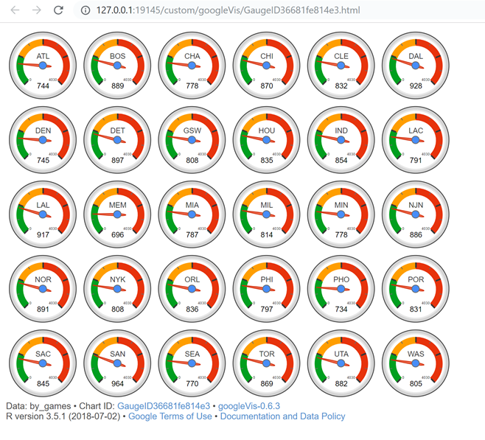
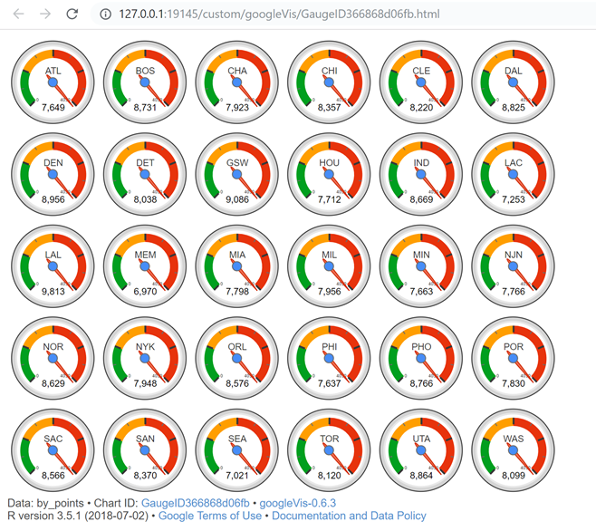
Five Google CHArt5-CHART GAUGE CHART
CHART-5(gAUGE CHART): Here I have used TOTAL POINTS AND GAMES PLAYED to reflect performance FOR EACH TEAMS.

Slide 23
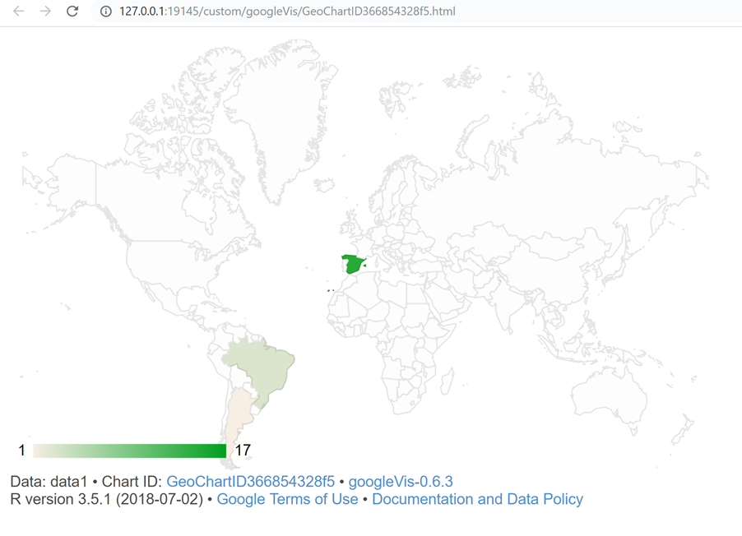
GOOGLE GEOCHART-ALL BASKETBALL CHAMPION
GEOCHART CHART:CLEAN the data- form a dataframe for eyar and country. Apply gvisGeochart function to the data.

Slide 24
SUMMARY
The analysis conducted to determine the performance of the player in the nba 2017-18.
Also on the basis of total point scored by a player-top 20 players is determined.
Success rate of the goals is calculated to be 46%~.
IF THE SAMPLING METHODS-on totalpoints ARE USED Instead of whole-data set then the objective of analyzing the performance of the player is served as it gives the visualization of probability distribution for a specified sample.

